Slide 1

Airport Authority Data Analysis
By
Prajna Ganji, Shiva, Neetika Upadhyay and Maruta Zalane

Slide 2
Introduction
Dataset:
Sourced from Kaggle’s Airline Delay and Cancellation Data (2009-2018).
Key Areas of Focus & Target Audience:
The key metrics for this analysis were the total number of flights, delays, and ground processing times and most importantly the analysis of proxy satisfaction score. The target audience for this presentation is management of the Airport Authority
What we want to achieve:
Create an interactive, user-friendly dashboard for exploring these metrics that could offer insights for airport management.

Slide 3
Objectives
Analyse total amount of flights, flight delays, ground processing time and passenger feedback from 2014 to 2018;
Create user friendly clear and concise dashboard that is easy to navigate by using filtering options that the user could apply

Slide 4
Methodology
Data collection
Getting to know the dataset
Data cleaning
Data transformation
Dashboard development

Slide 5
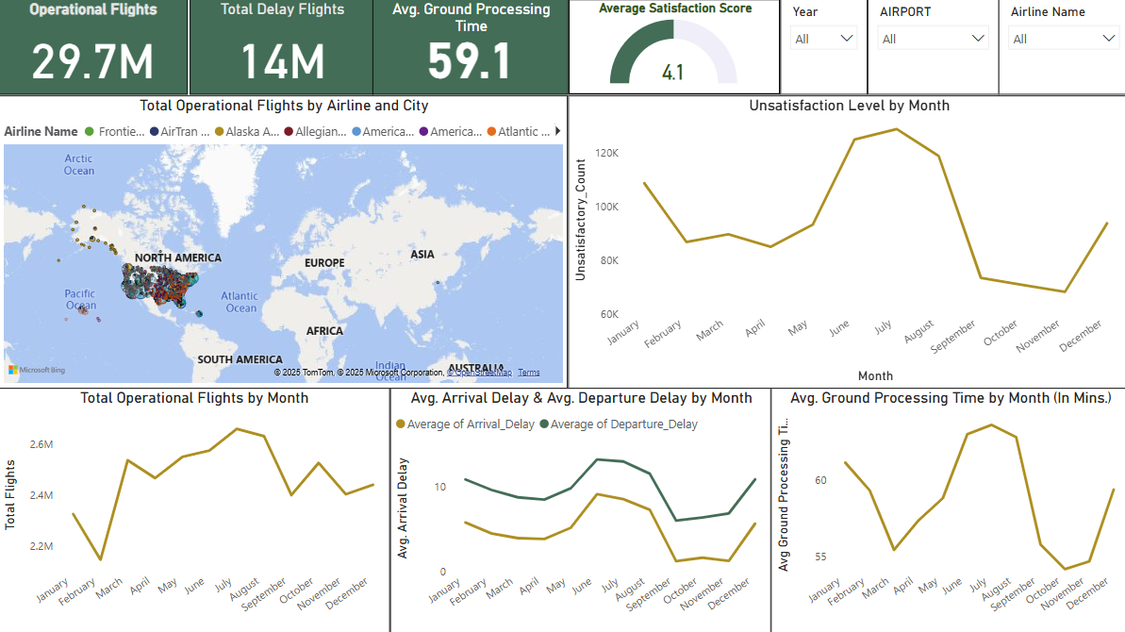
Performance Overview

Slide 6
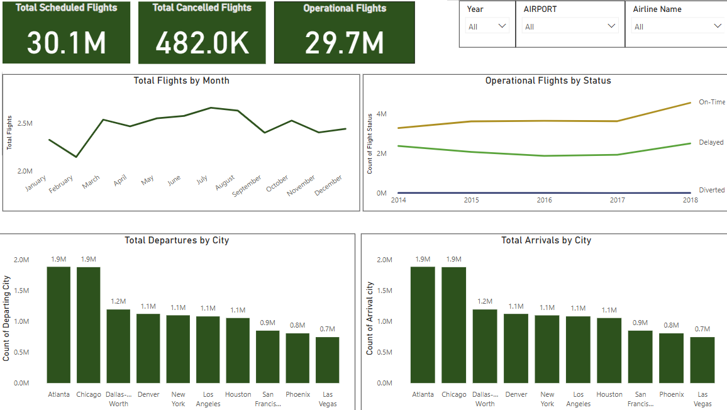
Total Number of Flights Analysis
Total Operational Flights soared in 2018
According to Forbes report, the growth in the number of flights may be driven by the expansion of route networks by various airlines.

Slide 7
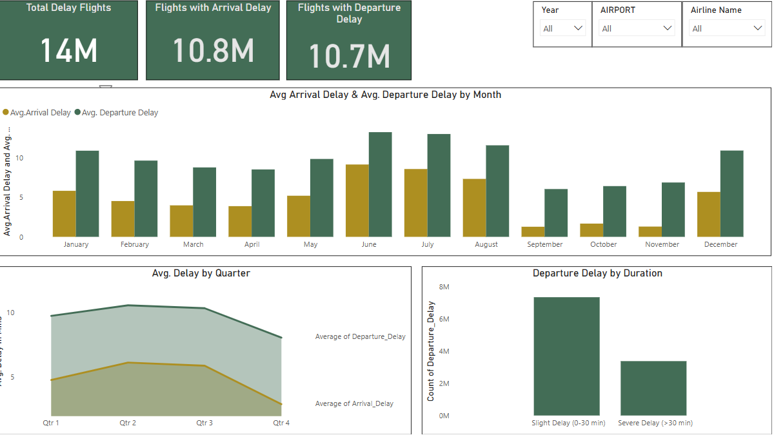
The Total Number of Flight Delays
Flight delays peaked during summer and Christmas vacations

Slide 8
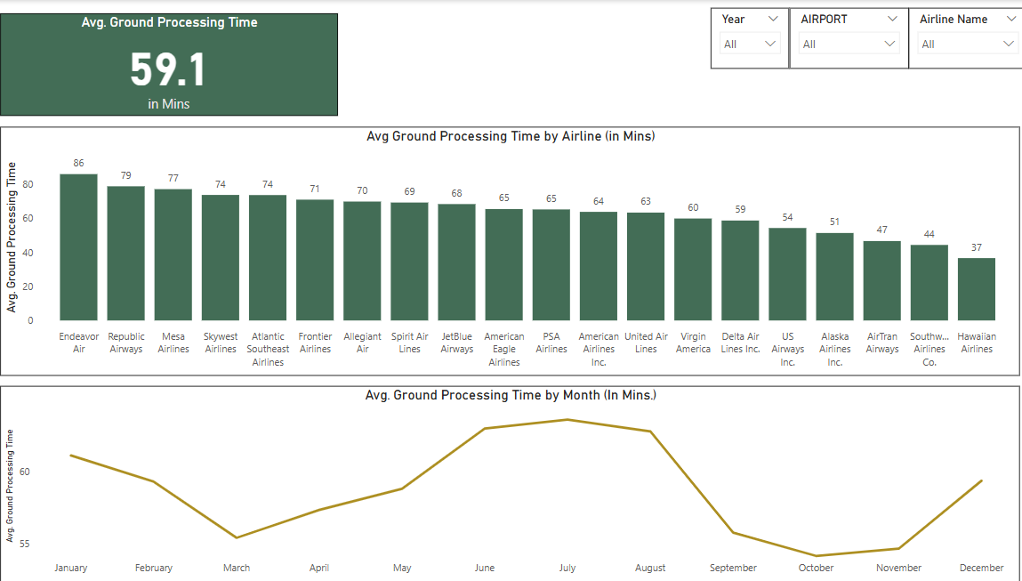
Ground Processing Time
Ground processing time meets industry standards

Slide 9
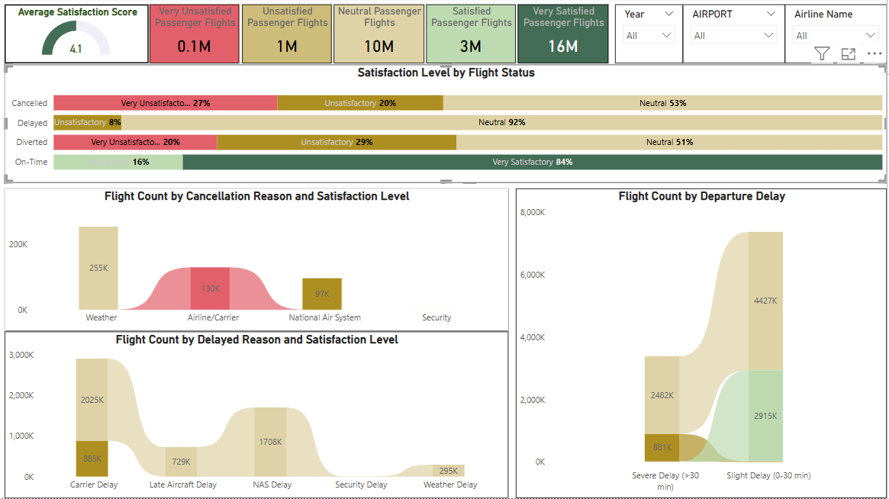
Satisfaction score
Airline-related cancellations & delays resulted in the lowest satisfaction scores.
Flights delayed by over 30 minutes had significantly lower satisfaction scores than slightly delayed flights.

Slide 10
Challenges
Integrating 5-year Data into one Table
Preparing Big Data for Analysis
Missing values in the dataset
Confusion in ground processing time calculation
No direct passenger feedback in the dataset

Slide 11
Key Takeaways & Next Steps
There is a noticeable increase of number of flights in 2018 in comparison to 2014-2017
Spikes in delays during high-traffic season
Average ground processing time is 59.1 minutes also impacted by high traffic season
There are a lot of factors that could impact that customer satisfaction is lower or higher, like, delays, cancellations and other factors
Airport management should focus on optimizing operations during peak travel months

Slide 12
Any questions?

Slide 13
Thank you for your attention!

